Slide 1





  ALL INDIA AGENTIC HACKATHON 2026
GOOGLE CLOUD
LEGACY LOCK
  A security Continuity & Claim-Preparation Platform for Financial and Digital assets
  -your family shouldn’t need a court order to find out what you left behind.

Slide 2



  ALL INDIA AGENTIC HACKATHON 2026
GOOGLE CLOUD
ROHIT – Leader, Backend Developer
PRIYANSHU KUMAR – Frontend developer
NISCHAL – Research lead
ANUSHRI YADAV – Presentation Lead

Slide 3
  ALL INDIA AGENTIC HACKATHON 2026
GOOGLE CLOUD
A REAL SCENARIO :
Consider Arjun –
His death is sudden. His family knows he likely had bank accounts, mutual funds, insurance, crypto and cloud documents – but not which institutions, which account identifiers, whether nominees were even registered, or what the claim process requires. Every institutions, which account identifiers, whether nominees were even registered, or what the claim process requires. Every institution has its own KYC, documentation, and legal-heir rules; there is no universal portal that can move money on their behalf.
THE PROBLEM
The Discovery gap : Grieving families often don’t know what bank accounts, crypto wallets, or digital vaults the deceased owned.
Corporate Harassments : Banks routinely ignore RBI’s 15-day claim settlement mandate, forcing families into months of court bureaucracy for succession certificates.
People have financial and digital assets distributed across many services, but their families lack a secure, trusted, and organized way to discover those assets and follow the correct next steps when the person is unavailable.

Slide 4

  ALL INDIA AGENTIC HACKATHON 2026
GOOGLE CLOUD
GROUNDED IN REAL LAW, NOT ASSUMPTIONS
Legacy Lock isn't a workaround. Every workflow maps to an existing Indian statute or regulatory directive — not an assumption about what a bank might allow.
DPDP Act 2023 (Section 14): Grants every citizen the explicit Right to Nominate someone to manage their digital legacy after death or incapacity.
Banking Regulation Act (Section 45ZA): Entitles the registered nominee to assume the complete rights of the account holder instantly.
Every Legacy Lock workflow is built to satisfy one of these three provisions — nothing more, nothing less.
RBI Master Circular: Orders banks not to demand court documents like Wills or Succession Certificates when a nominee exists — settlement is due within 15 days.

Slide 5
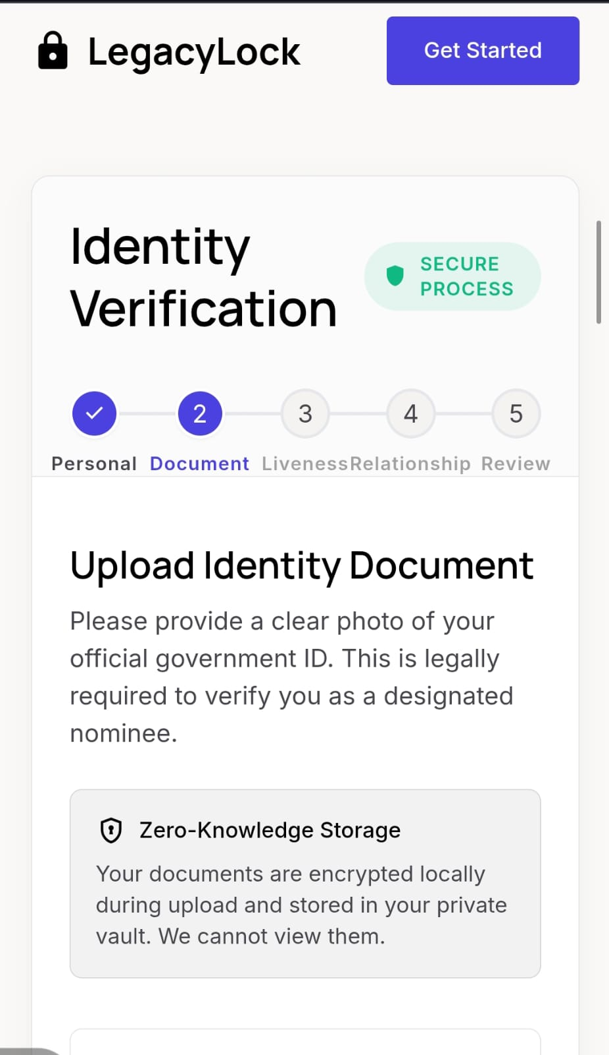
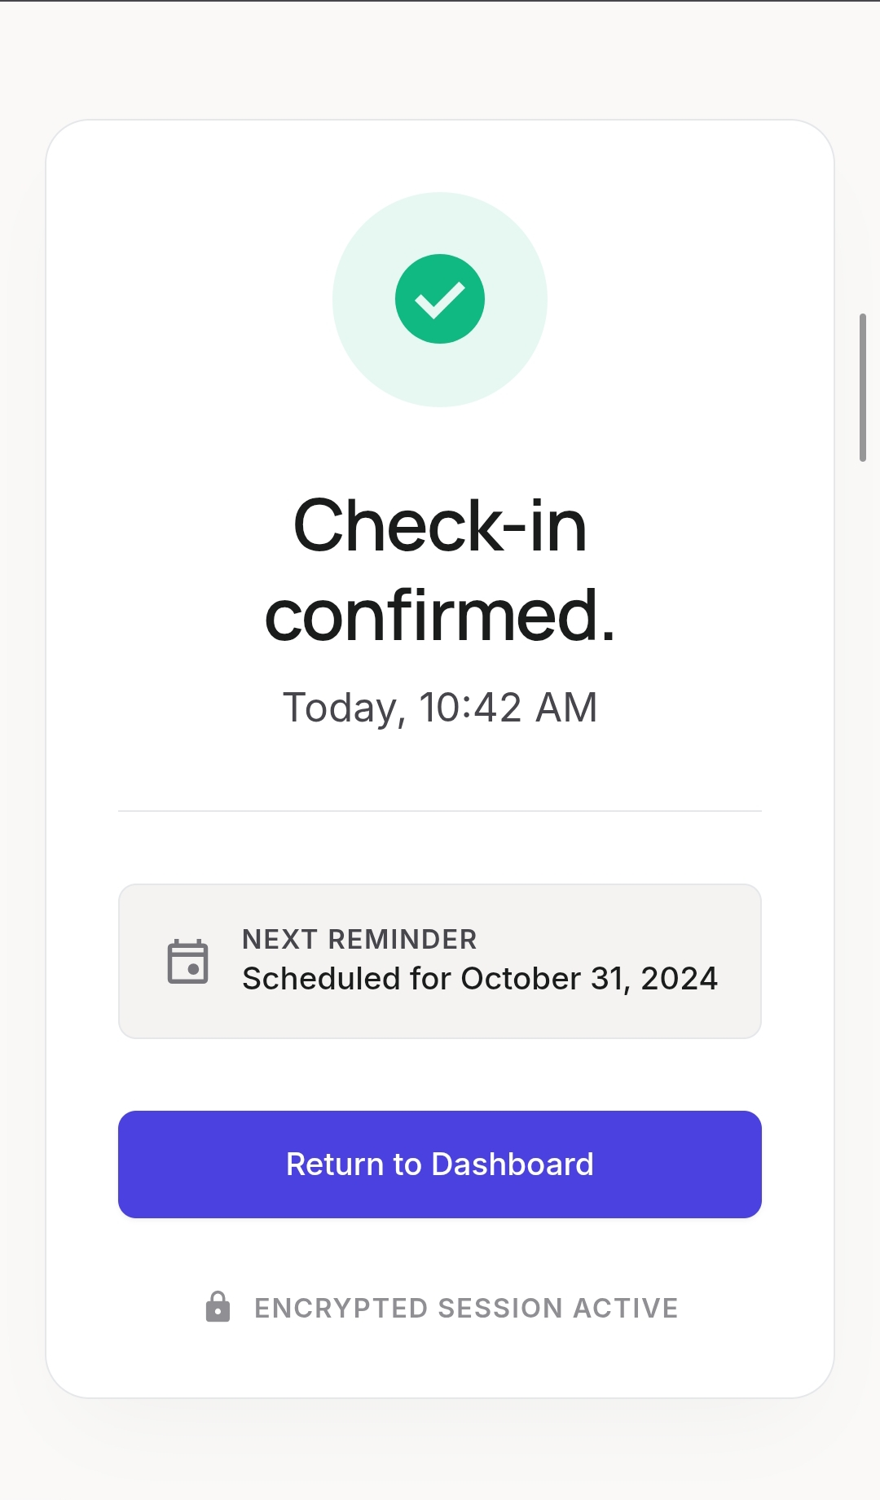
  ALL INDIA AGENTIC HACKATHON 2026
GOOGLE CLOUD
THE ROLE OF AI — CLEARLY BOUNDED
AI Does:
OCR and structured field extraction
Missing-document detection
Institution-specific checklist suggestions
Arranging approved information into dossier format.
AI Never Does:
Final certification of death
Decide a legal heir or nominee
Approve an automatic release
Declare a document genuine— every one of these needs a human.

Slide 6

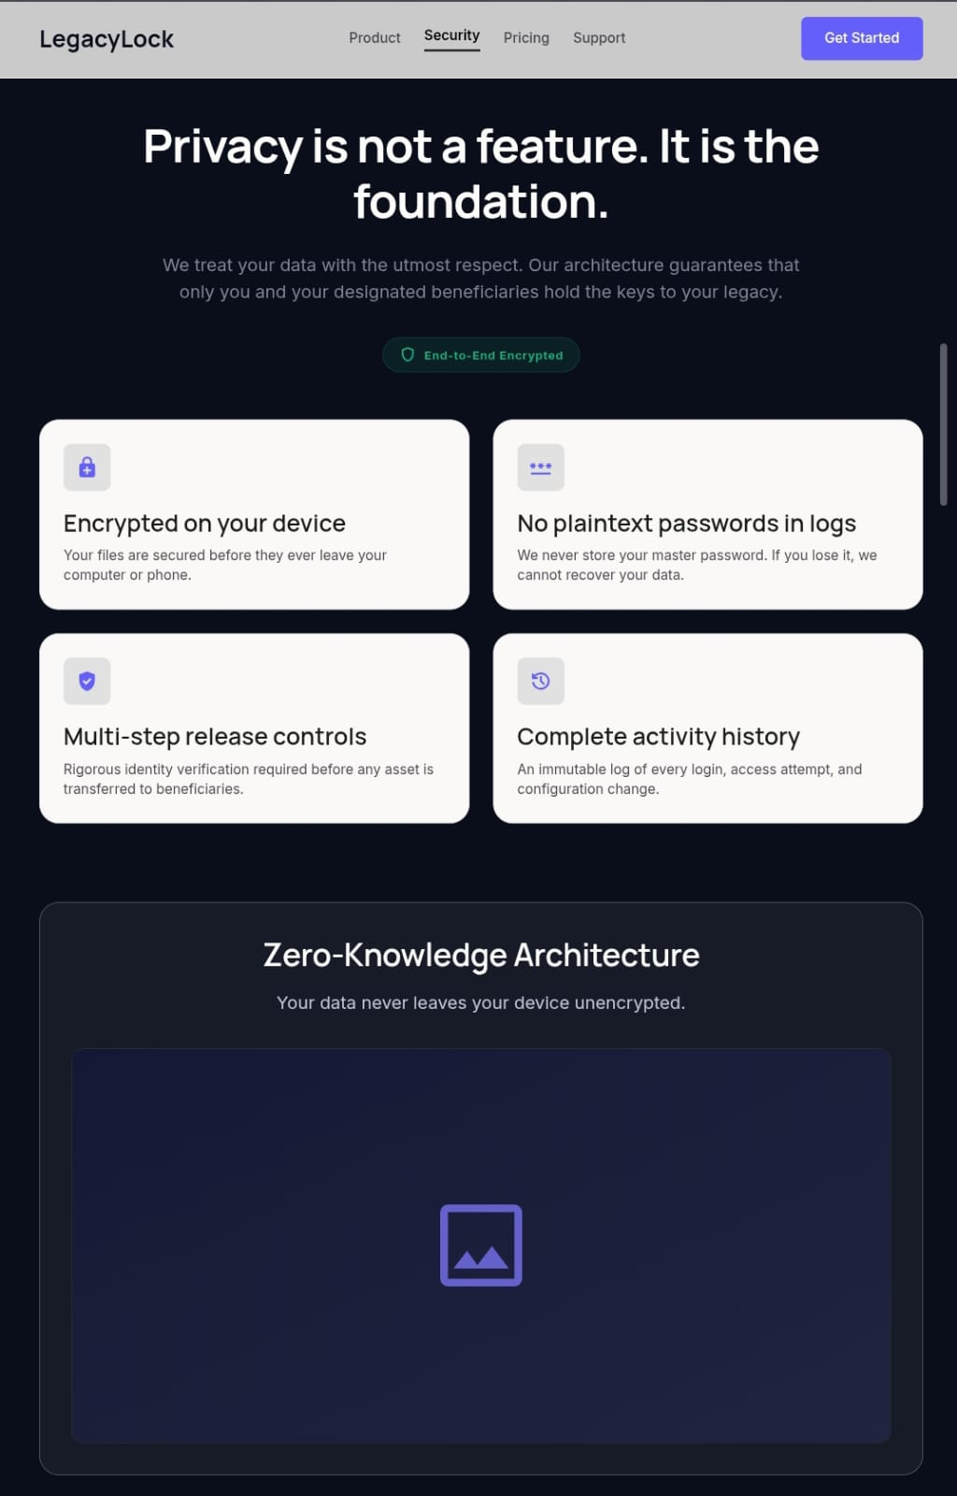
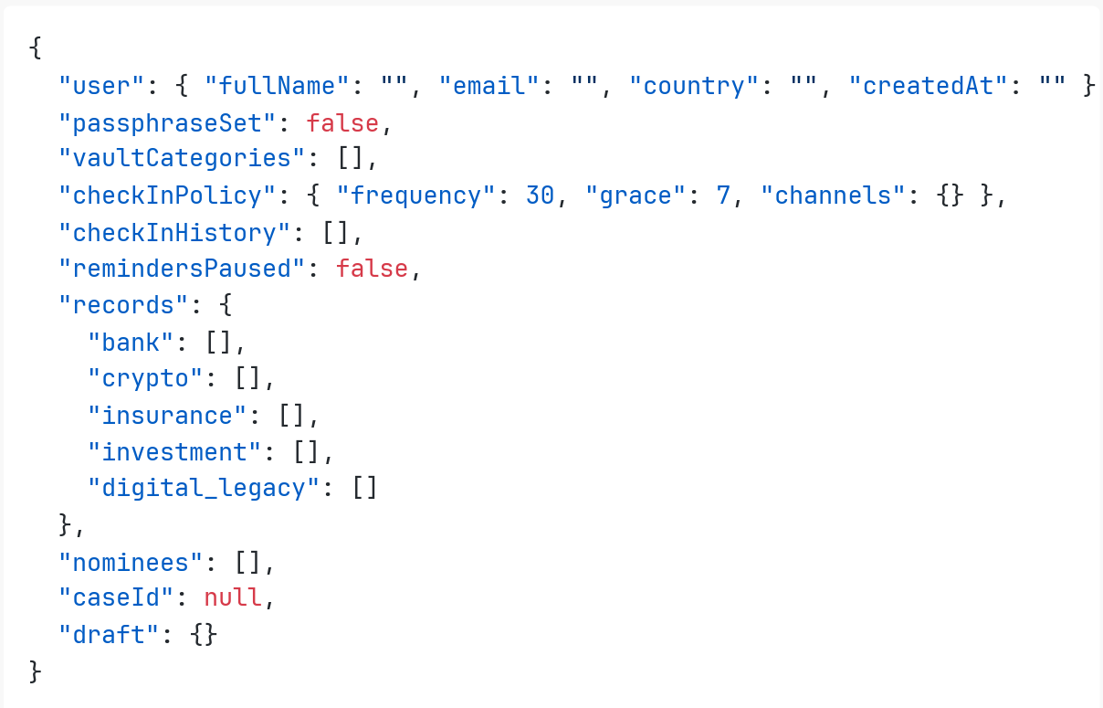
  ALL INDIA AGENTIC HACKATHON 2026
GOOGLE CLOUD
FROM SILENCE TO A VERIFIED CLAIM
Step 1 — User Input: User locks minimal bank and asset metadata inside the encrypted vault.
Step 2 — The Silence Trigger: User misses three consecutive scheduled Whats-App check-ins.
Step 3 — Biometric Handshake: The designated nominee undergoes multi-factor secure KYC validation.
Step 4 — Autonomous Delivery: Gemini parses the data and auto-generates a downloadable, RBI-compliant Deceased Claim Dossier.

Slide 7
  ALL INDIA AGENTIC HACKATHON 2026
GOOGLE CLOUD
API LAYER :
Technologies-
NestJS Guards, Interceptors, and Pre-signed URLs.
Purpose-
Secure communication, throttles requests via rate-limiting, and generates encrypted temporary upload links.
DATABASE & STORAGE :
Technologies-
PostgreSQL 16, Prisma ORM, and Cloud Object Storage (AWS S3 / GCS)
Purpose- Guarantees ACID compliance for immutable audit Trails, runs full- text asset searches, and holds encrypted vault documents.
TECH STACK -
FRONT-END :
Technologies-
Client web/Mobile App interacts securely with the system
Purpose-
Handles secure user sessions, vault management, and document uploads.
BACK-END :
Technologies-
Node.js 20 LTS, TypeScript, NestJS, Redis 7 + BullMQ
Purpose-
Executes business rules, processes check-in reminders, scales escalation workflows, and handles background notification dispatch.
  *THANK YOU – TEAM LEGACY LOCK*

